Slide 1
Bifurcation Diagram

Slide 2
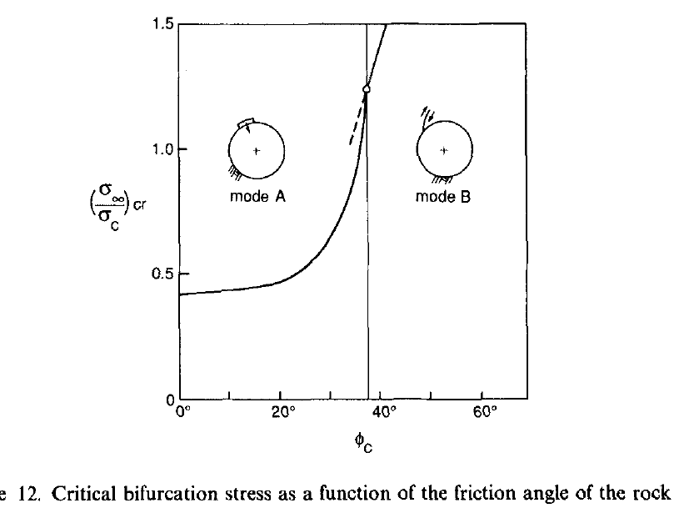
(Vardoulakis and Papanastasiou, 1988)

Slide 3
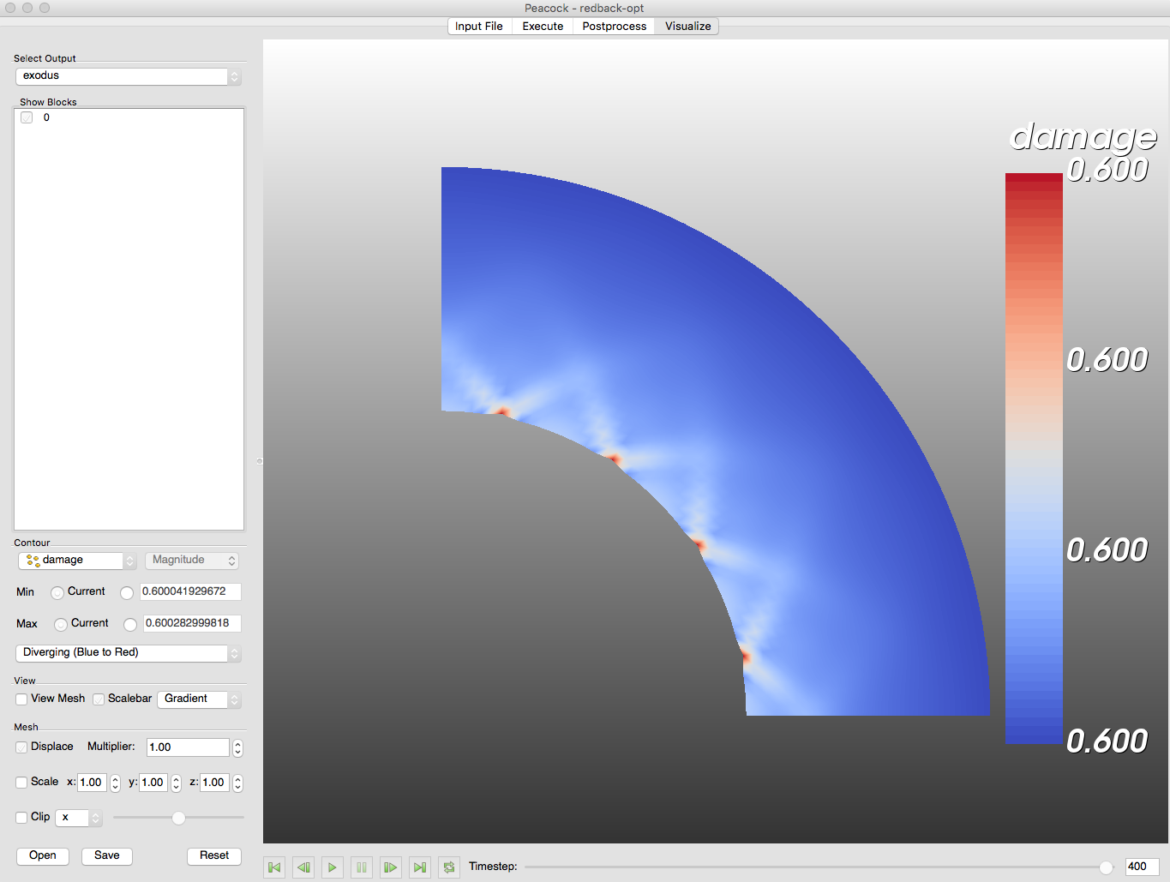
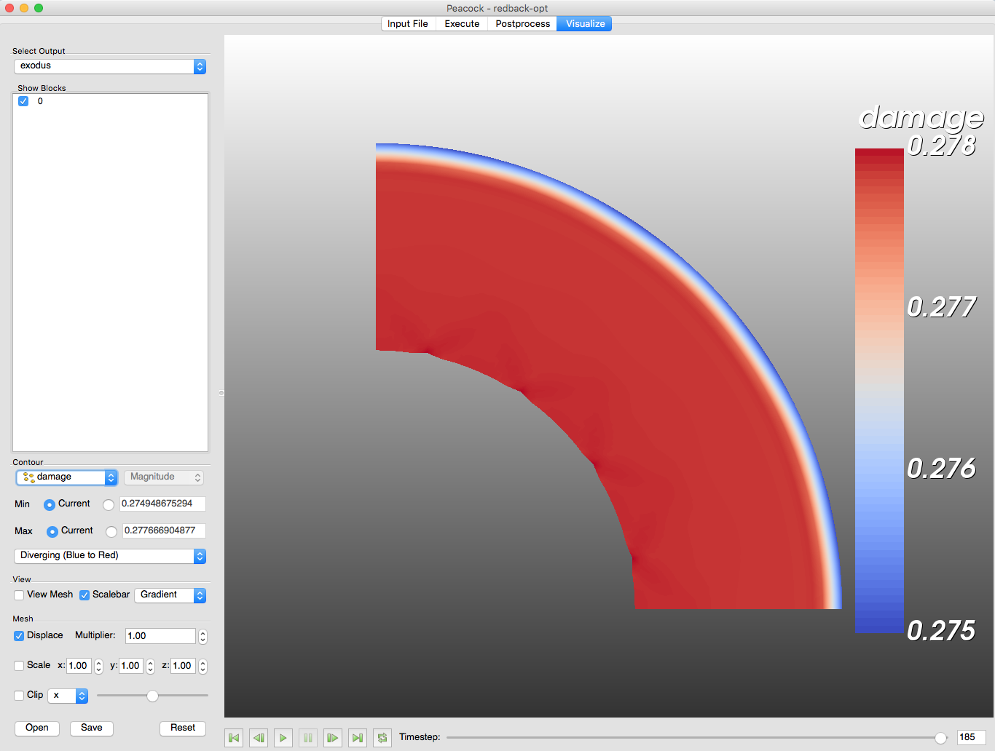
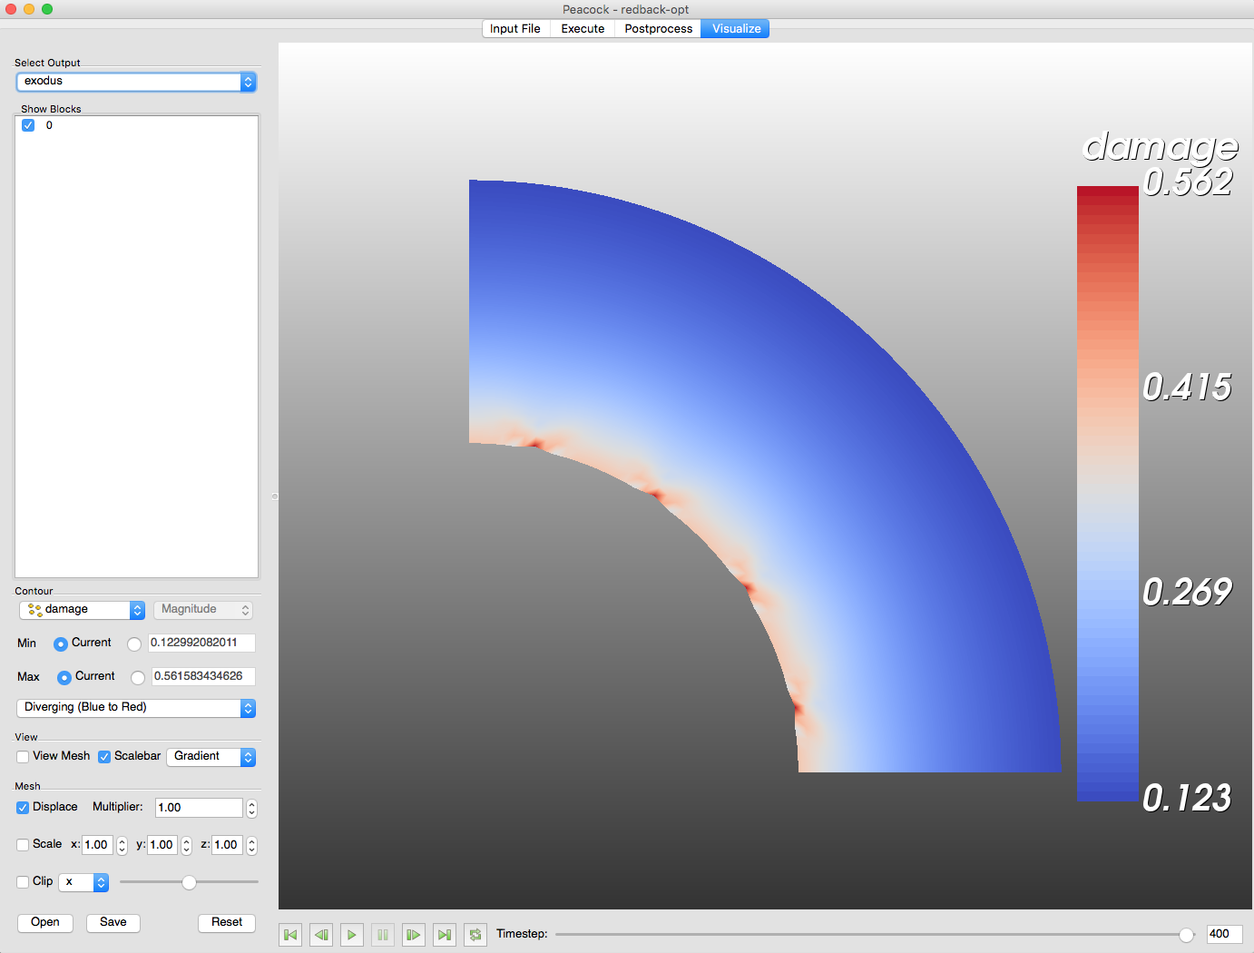



$\frac{σ_{out}^{∗}}{σ_{in}^{∗}}=0.33$, slope = 0
$\frac{σ_{out}^{∗}}{σ_{in}^{∗}}=0.5$, slope = 0
$\frac{σ_{out}^{∗}}{σ_{in}^{∗}}=2$, slope = 0
No shear-banding, neither observed in the evolution of mechanical dissipation
Notes:
Sigma_out = 1e-3 fixed. Sigma_in = 3e-3, 2e-3, 5e-4.
Corresponds to Thin_test_1.e, Thin_test.e, Thin_test_2.e.

Slide 4
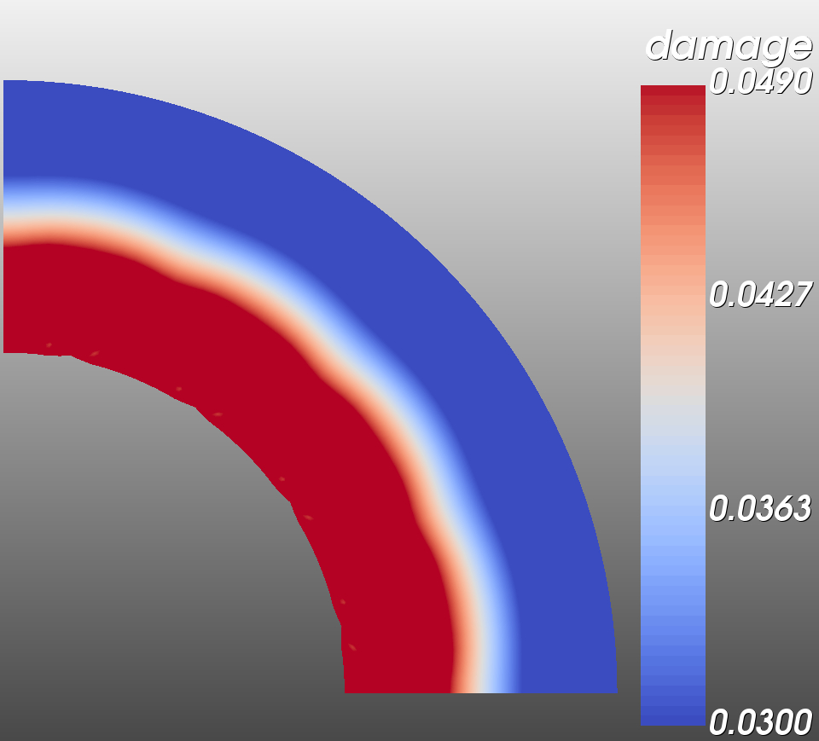
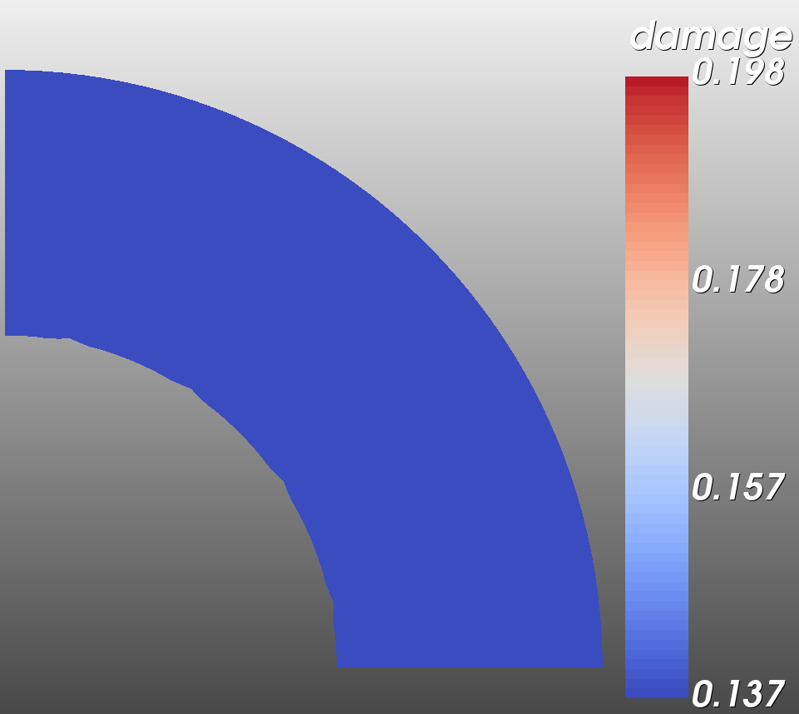
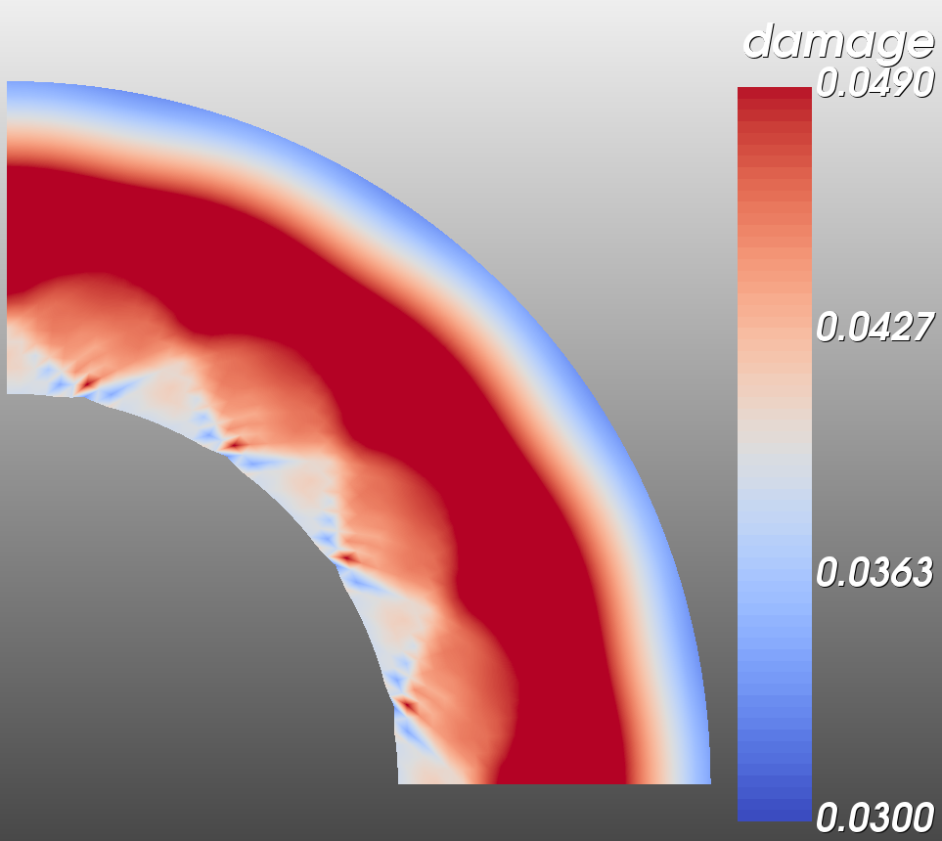
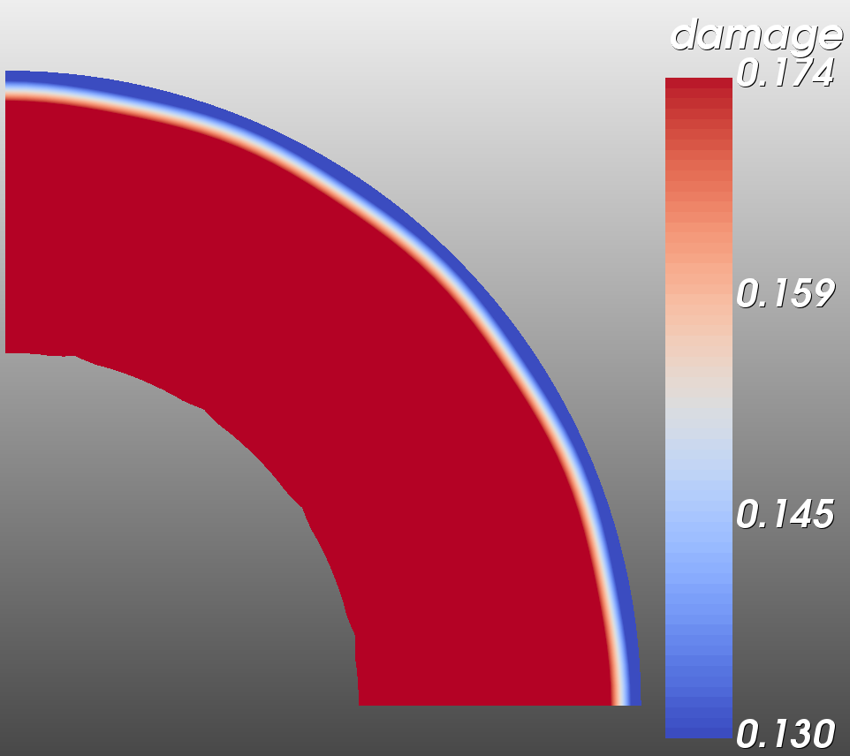
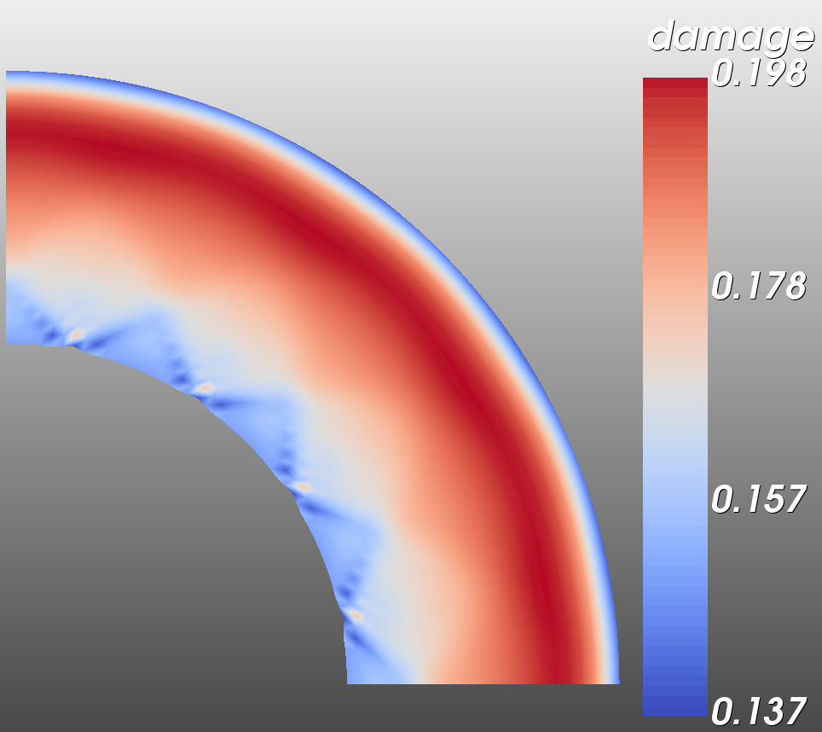
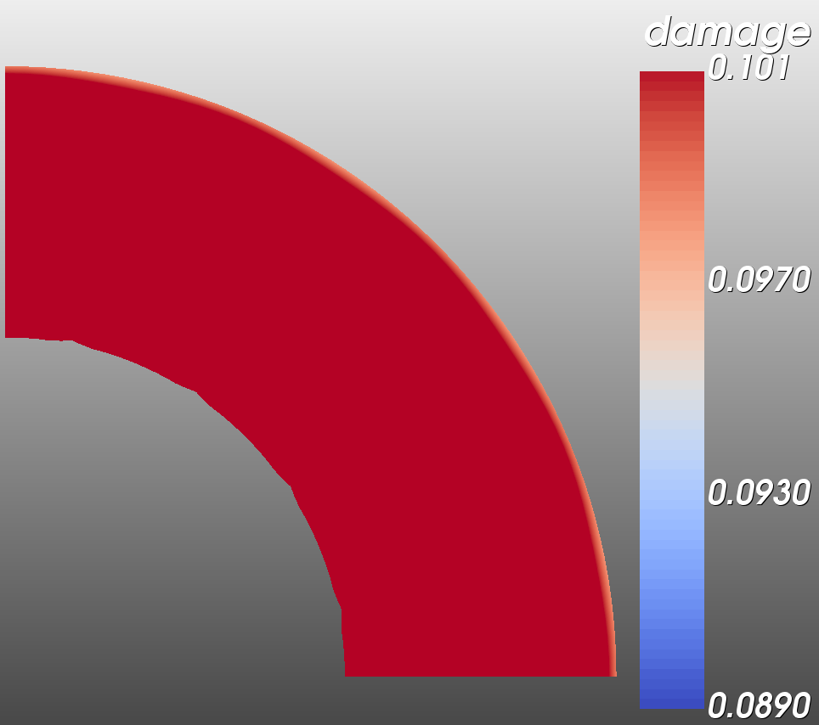
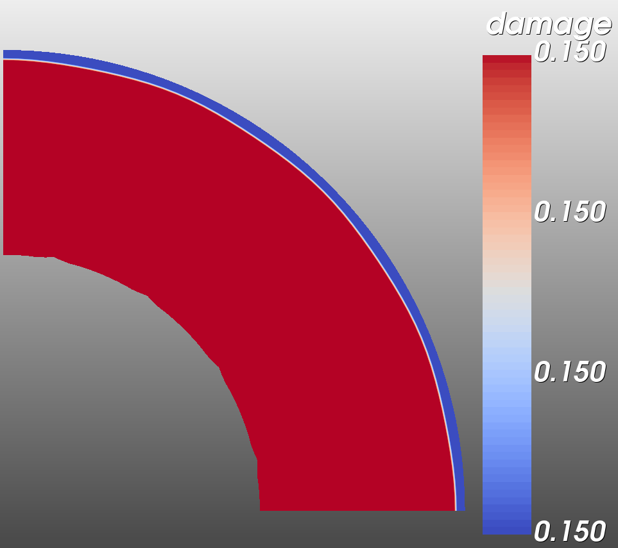
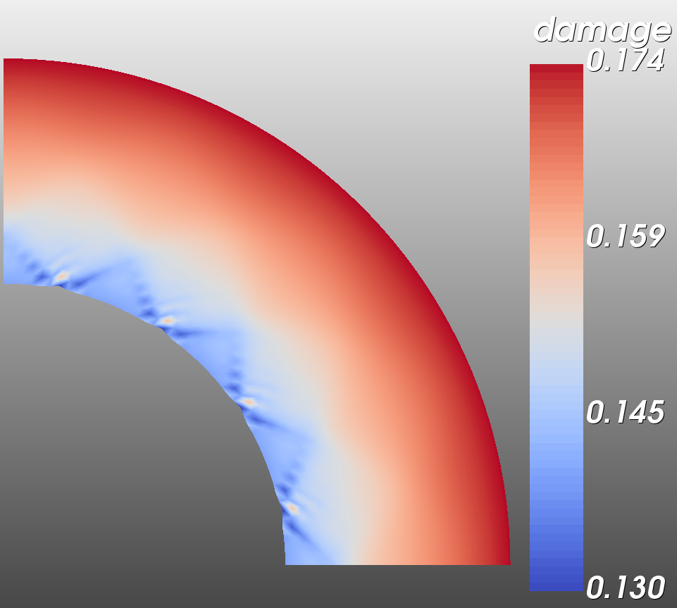
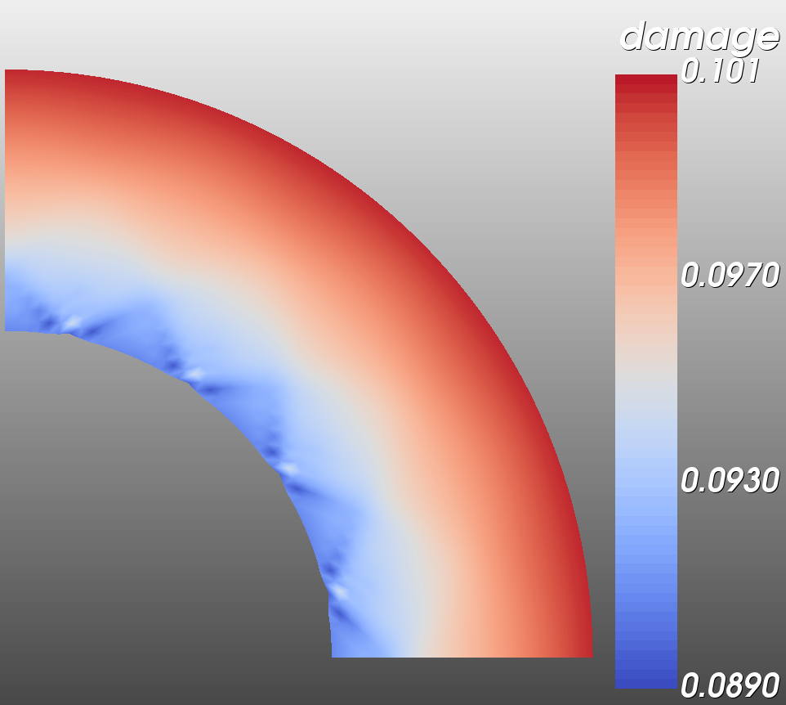
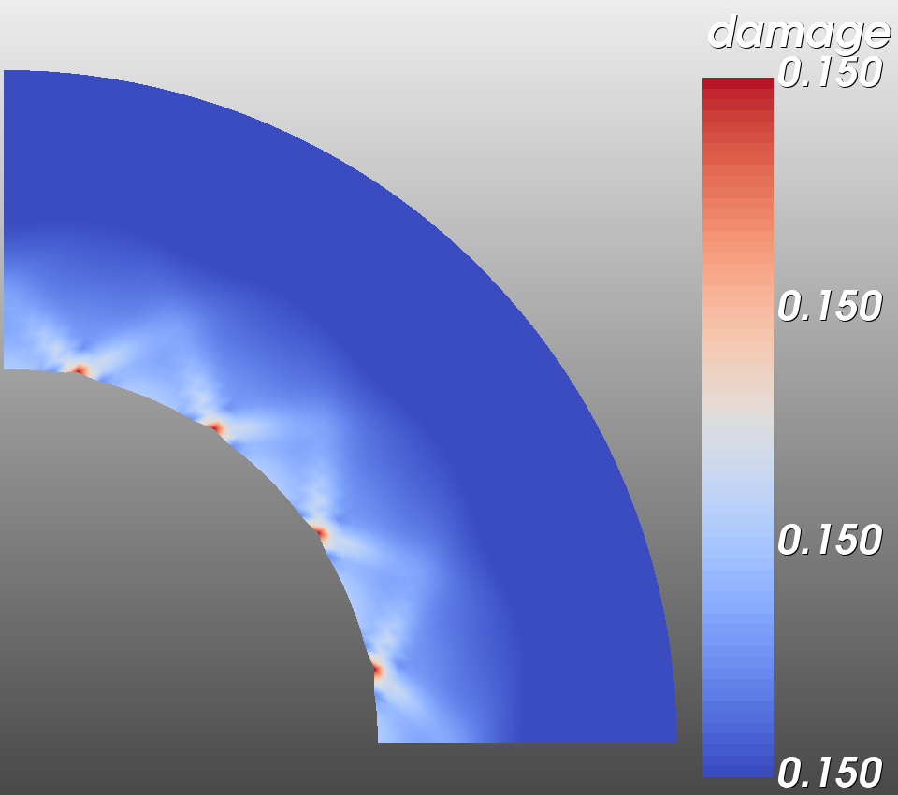
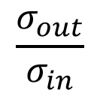
Time step=50
$$\frac{σ_{out}}{σ_{in}}$$
Time step=100
(0.55, 1.0)
1.0
Time step=100
(0.45, 0.83)
(0.55, 0.83)
0.75
Time step=100
(0.3, 0.75)
(0.45, 0.75)
Time step=100
0.5
(0.15, 0.67)
(0, 0.5)
(0.3, 0.5)
(0.15, 0.33)
0.25
(0, 0.25)
0
0.15
0.3
0.45
0.55
slope
Damage pattern (same scale)

